Slide 1
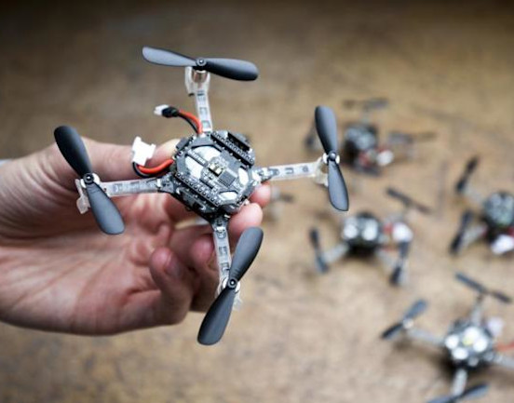
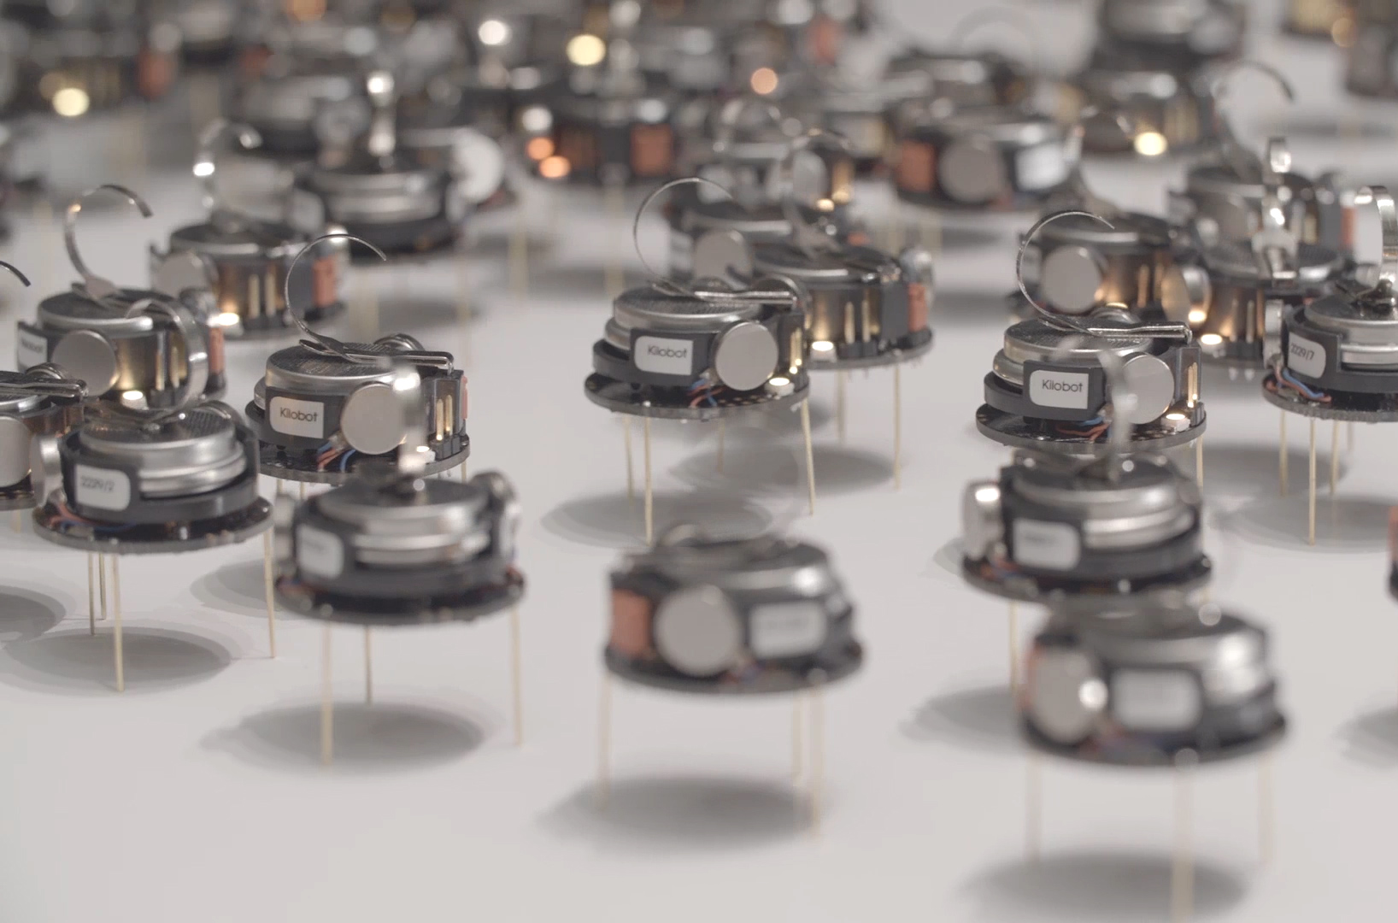
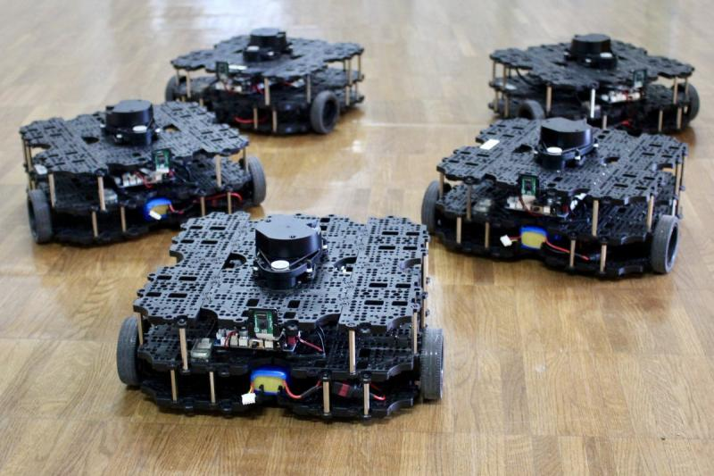

ECE693H, Spring 2025: Multi-robot System Design
“Course Intro”
Dr. Daniel Drew

Slide 2
Multi-robot Systems

Slide 3
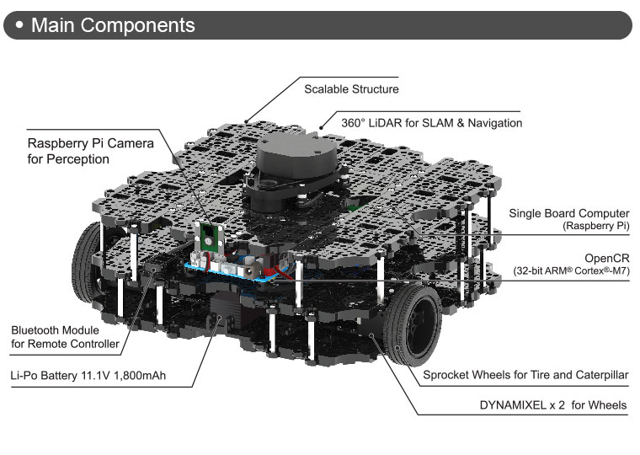
Multi-robot Systems: Wheeled Robots
Turtlebots

Slide 4
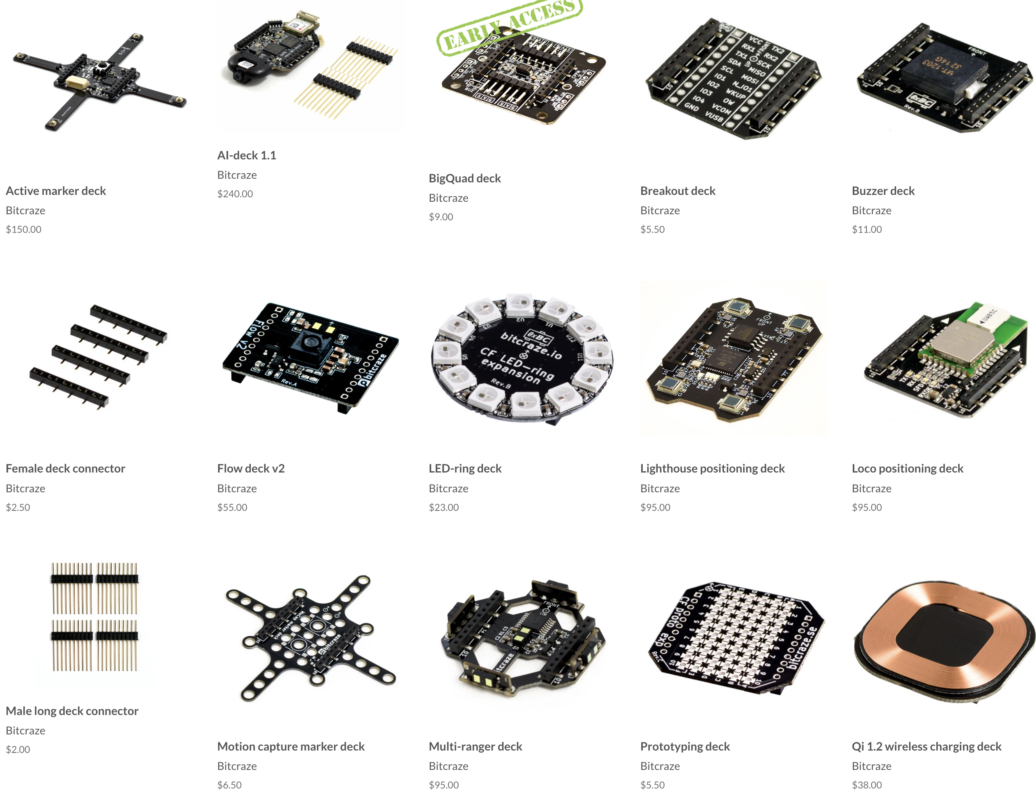
Multi-robot Systems: Micro Air Vehicles
Crazyflies

Slide 5
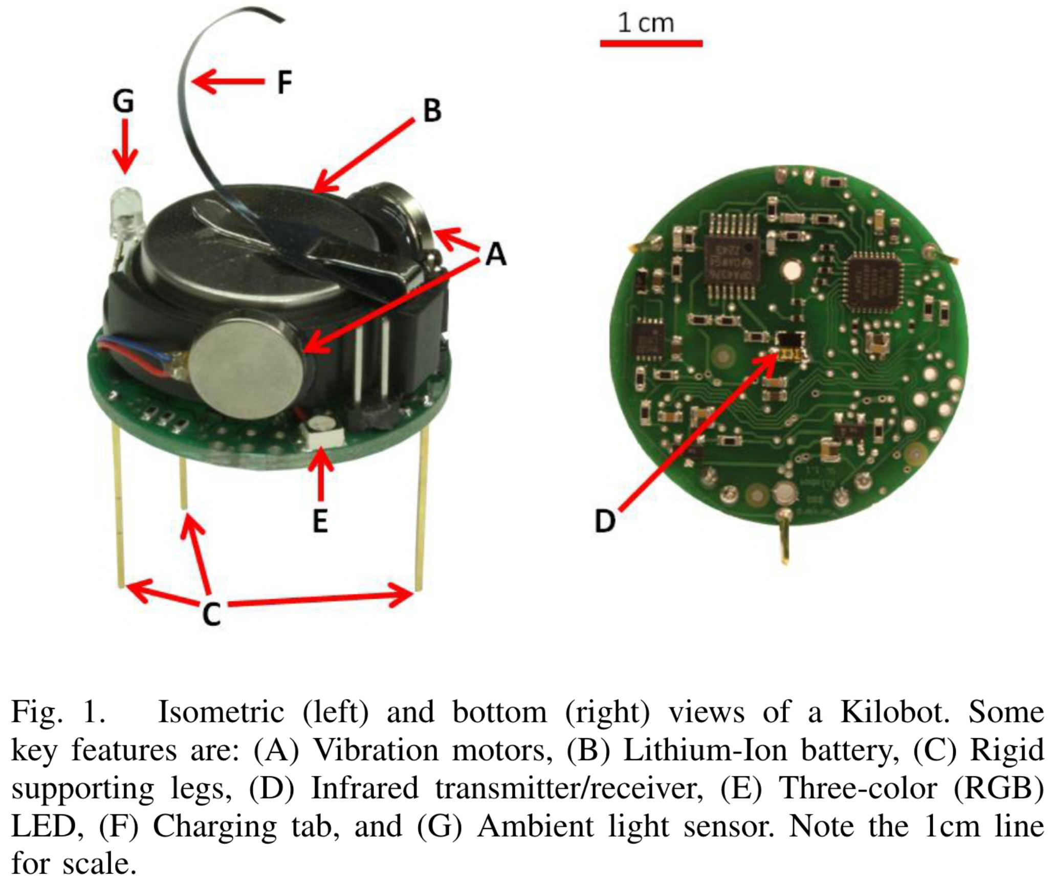
Multi-robot Systems: Millisystems
Kilobots
Rubenstein et al. 2012

Slide 6
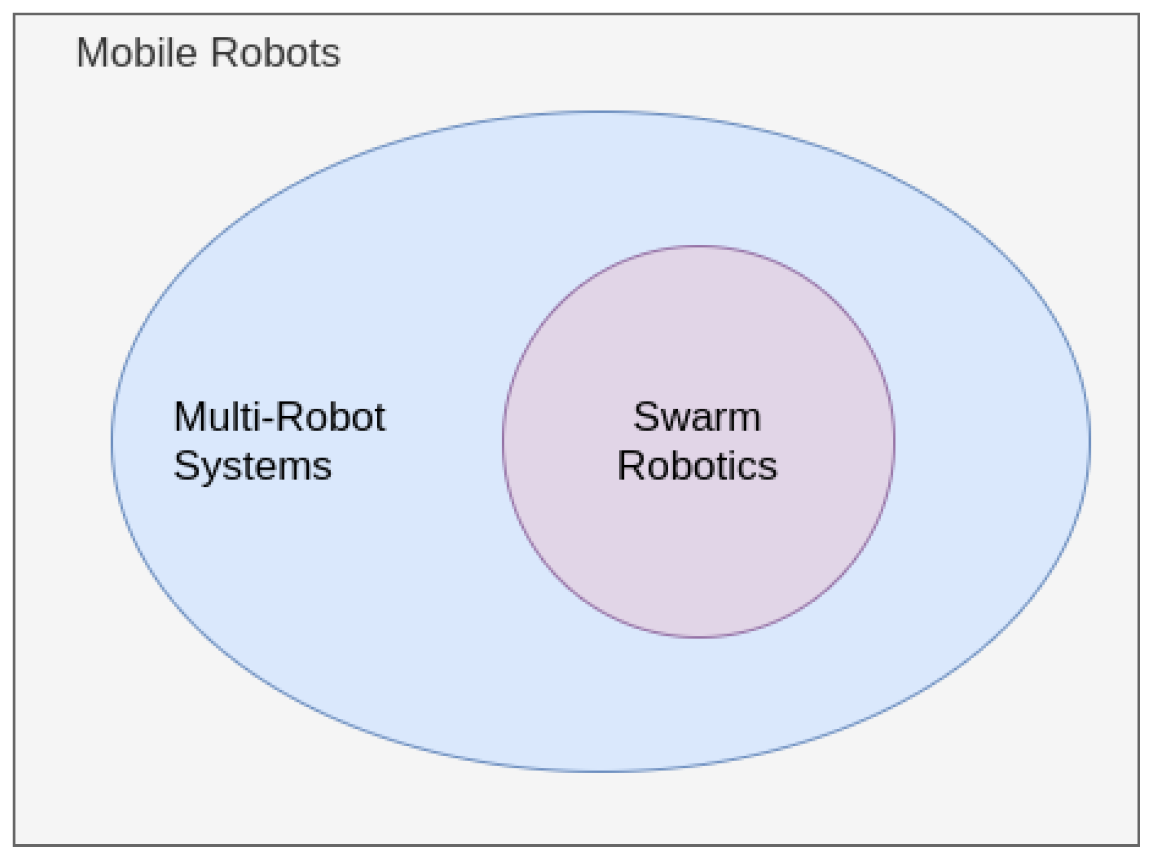
Multi-robot Systems vs Swarms

Slide 7
Multi-robot Systems vs Swarms
10m
killer whale
groups
tuna
1m
hyena
geese
swarms
0.1m
flocks
krill
Agent Size
1cm
social insects
1mm
zooplankton
100um
1-10um
bacteria
1
10
100
1000
10,000
100,000
Group Size
(adapted from slide by V. Kumar)

Slide 8
Multi-robot Systems vs Swarms
10m
MRS
swarms
impossible
1m
Unpopular opinion in public, popular opinion in private:
0.1m
The term “swarm” has been used and abused, and is now meaningless.
Agent Size
1cm
1mm
100um
1-10um
1
10
100
1000
10,000
100,000
Group Size

Slide 9
Outline for Today
Introduce myself to you
Meet some of your classmates
Course info
In-class Activity

Slide 10

Course Instructor
Dr. Daniel Drew
Instructor
Assistant Professor, ECE

Slide 11





Course Instructor
BS, MSE
PhD, EECS
Postdoc, ME
Asst. Professor, ECE
Small-scale railgun
Prototyping Tools
Human-Swarm Interaction
Nanoelectronics
Insect-scale Millirobots
Soft Robots
Aug. 2024
Dr. Daniel Drew
Instructor
Assistant Professor, ECE
Asst. Professor, ECE

Slide 12
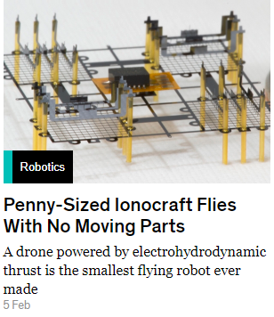
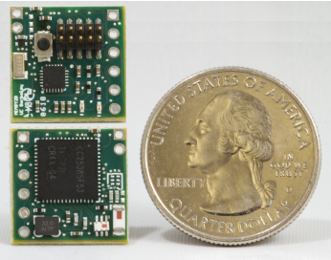
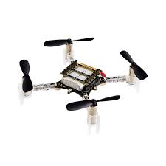
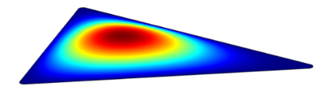
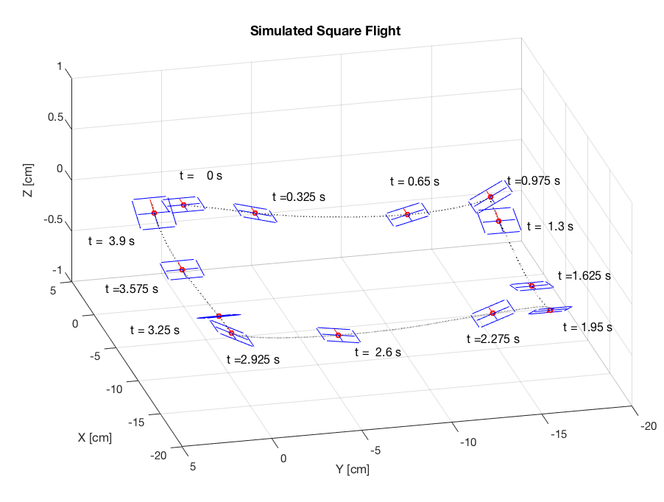
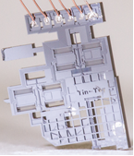
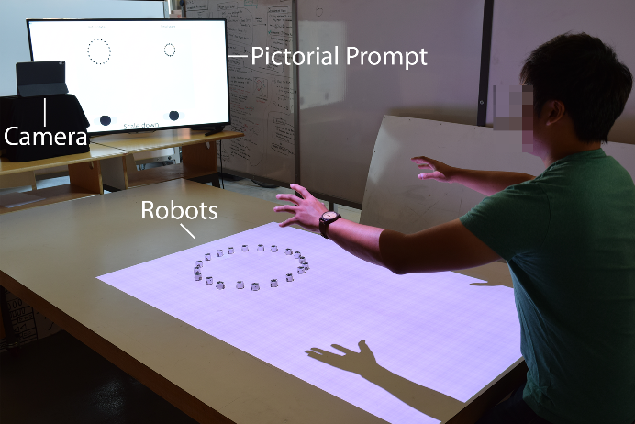
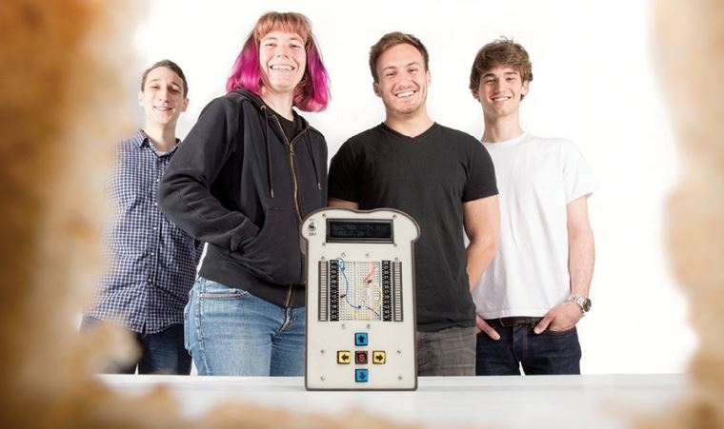
Dr. Daniel Drew – Assorted Research Projects
milliflyers
wsns
quadrotors
biomimetics
milliwalkers
swarms
control systems
design tools

Slide 13


Novel
Mechanisms
ubiquitous insect-scale robots
🐝
MEMS, swarms, autonomy
Microrobotics
Multifunctional
Components
Artificial
Ecosystems
Notes:
So here at the U I’ve established the Drew Research Lab, where we work to build ubiquitous insect-scale robots. That combines efforts drawing from the fields of MEMS and microsystems, swarms – or how to get these robots to communicate and cooperate– and autonomy, especially difficult for resource constrained platforms.

Slide 14
Novel
Mechanisms
🐝
Microrobotics
Multifunctional
Components
Artificial
Ecosystems
Notes:
There are three overarching themes to the work. Novel mechanisms, so designing new actuators and platforms at scale. Multifunctional components, which can overcome resource constraints through methods inspired by the natural world. And ecosystems, or the surrounding infrastructure and swarm composition that lets the robots succeed.

Slide 15
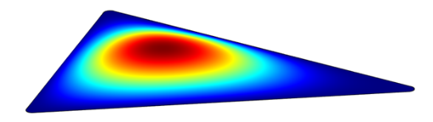
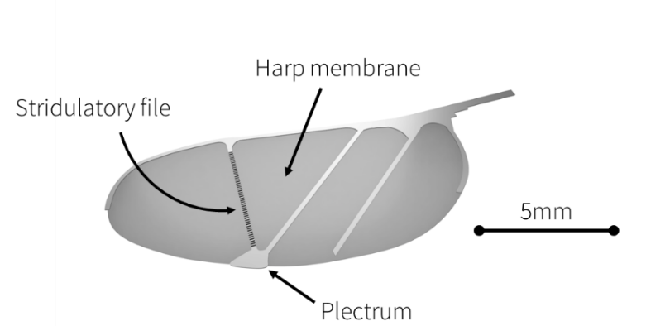
Acoustic Communication and Sensing
Novel
Mechanisms
🐝
Microrobotics
Multifunctional
Components
Artificial
Ecosystems
Notes:
A quick example of a multifunctional component might be a new design for a wing, which draws inspiration from those of crickets and katydids. Instead of adding a separate speaker and microphone to our robots, what if the wing itself functioned as an acoustic transducer? Think of a crickets chirp.

Slide 16

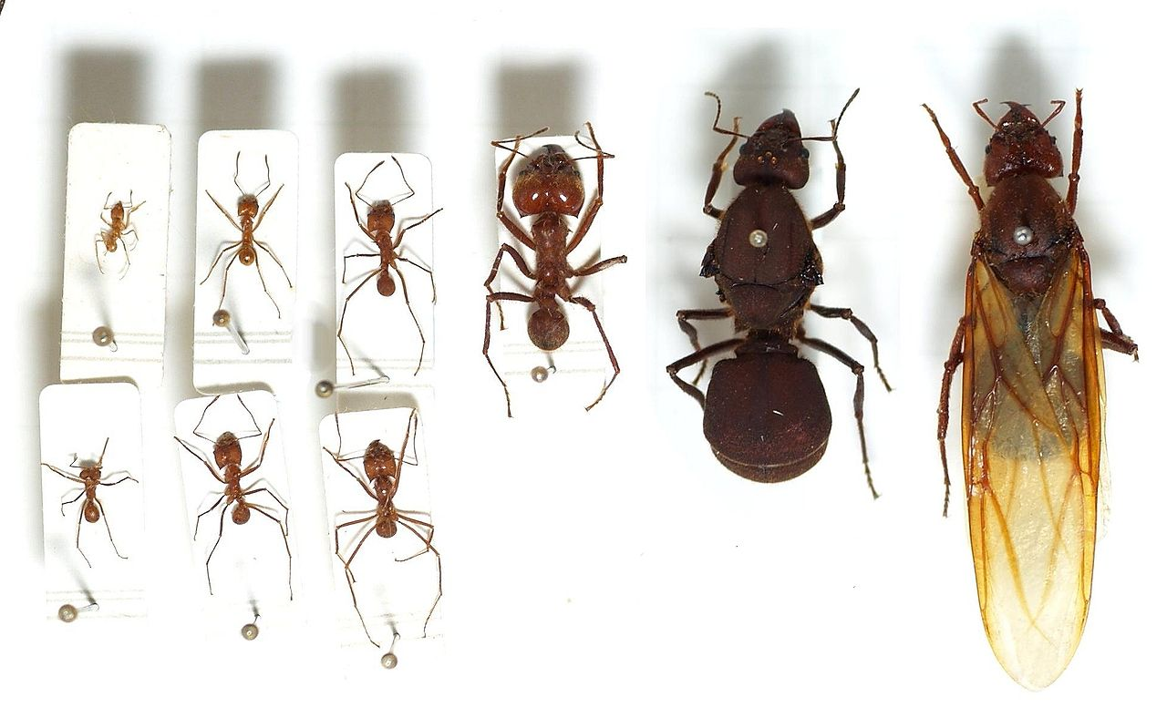
Heterogeneous Swarms
Novel
Mechanisms
🐝
Microrobotics
Multifunctional
Components
Artificial
Ecosystems
Notes:
On the ecosystem side, it’s important to realize that insects don’t just succeed on their own. They often function in heterogeneous swarms, where task specialization allows them to work together more effectively. And they have infrastructure they develop which helps ensure success. So we look at ways to emulate this kind of approach artificially.

Slide 17
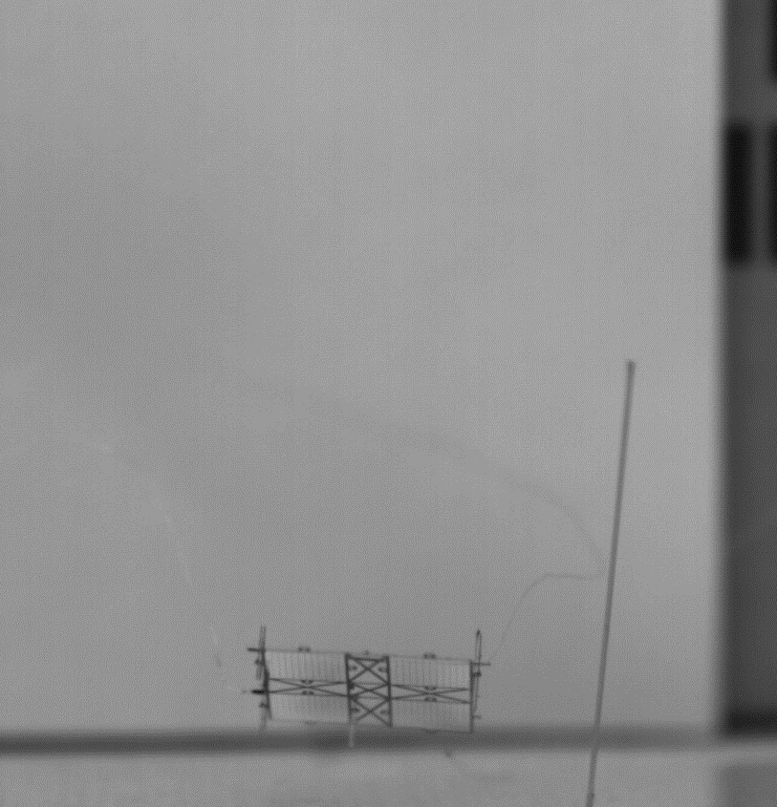
Flying Microrobots With No Moving Parts
Novel
Mechanisms
🐝
Microrobotics
Multifunctional
Components
Artificial
Ecosystems
Notes:
But for this talk, I’m going to focus on the development of novel mechanisms, specifically a new actuation method for flying robots. A large amount of my work has been developing these atmospheric ion thruster powered robots, which can fly completely silenty, and with no mechanical moving parts.

Slide 18

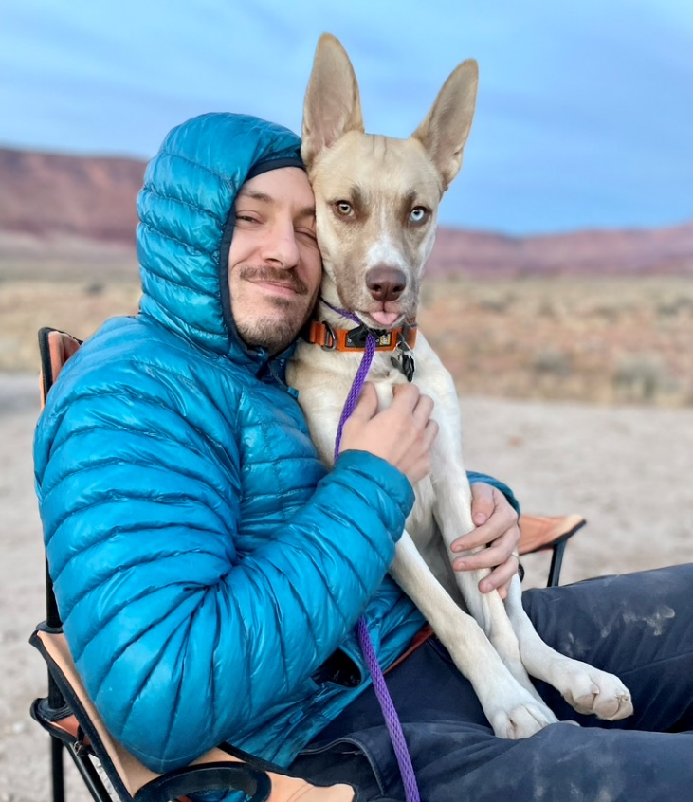

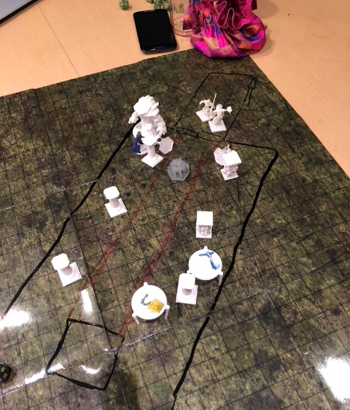
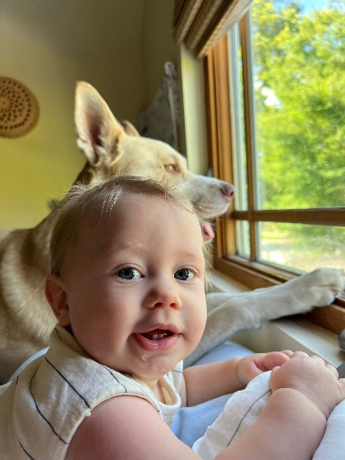

Dr. Daniel Drew – Also a Human Being
Playing Inside and Outside
My wife Emily
(also UHM prof. at WRRC)
My dog Tuna
My son Silas

Slide 19
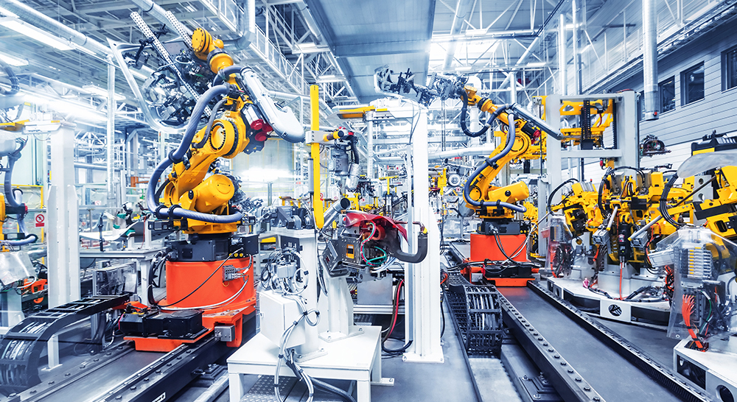
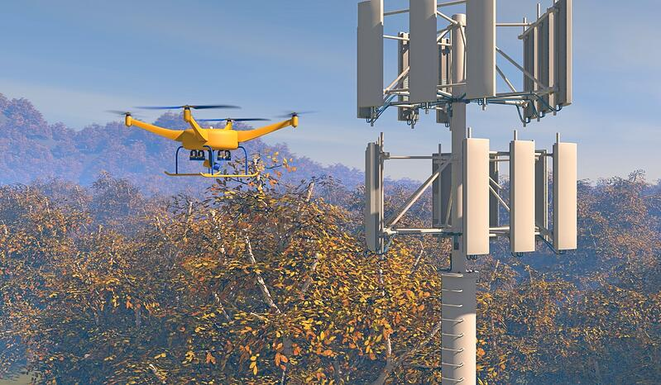
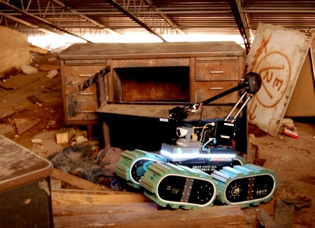
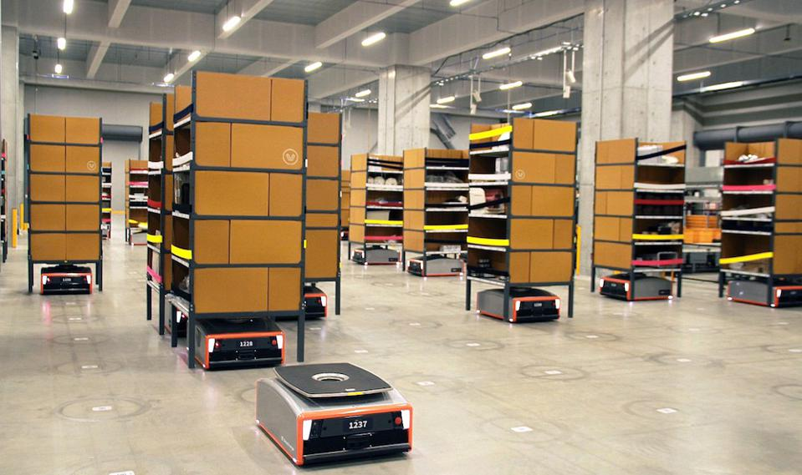
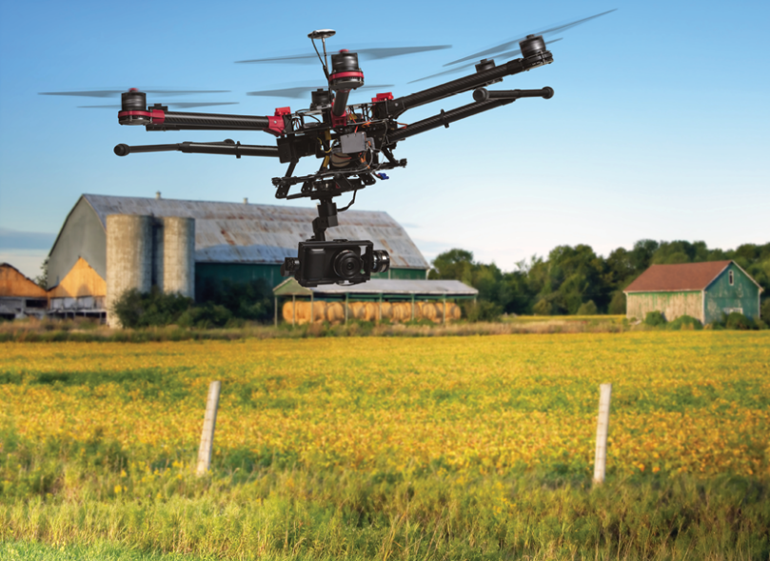
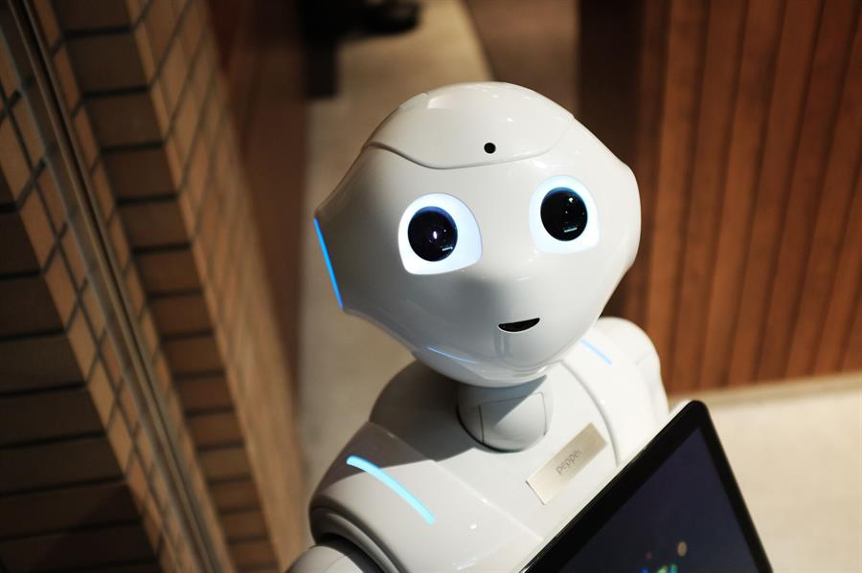
Modern Robots in the Wild

Slide 20
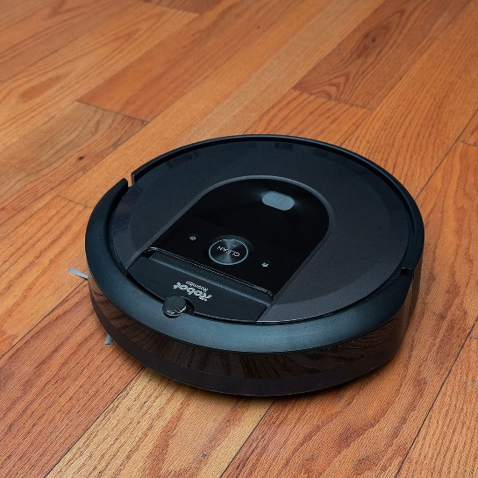
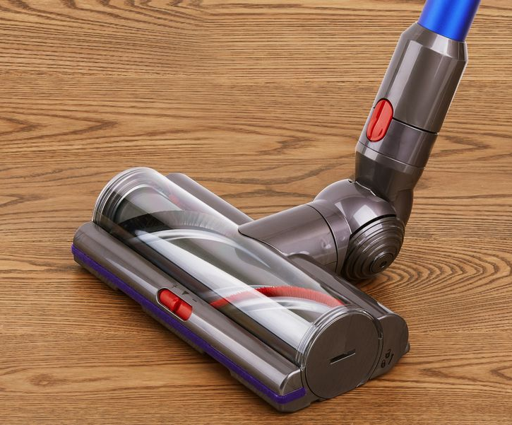
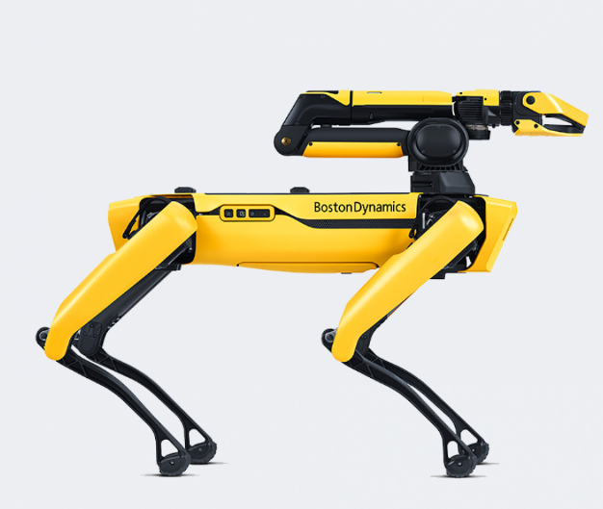
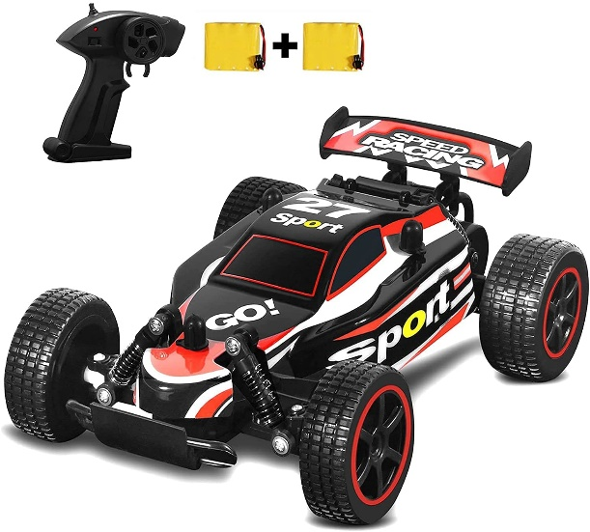
Small Group Activity: ~2 minutes
With your neighbor(s), discuss:
What makes something a ROBOT? No wrong answers!
Food for thought:

Slide 21
What Makes Something a Robot?

Slide 22

Course at a Glance: “Swarm-on-a-Stick”
We will create an open-source swarm robotics kit for education, from scratch.
Things you will do:
-PCB design, fabrication, and assembly
-Modeling and 3D printing structural components
-Firmware and software coding including SOTA micropython, ROS2
-Listen to lectures about autonomous mobile robots and multi-robot systems
-Become better presenters
-Become more proficient at working as part of an engineering / product design team

Slide 23
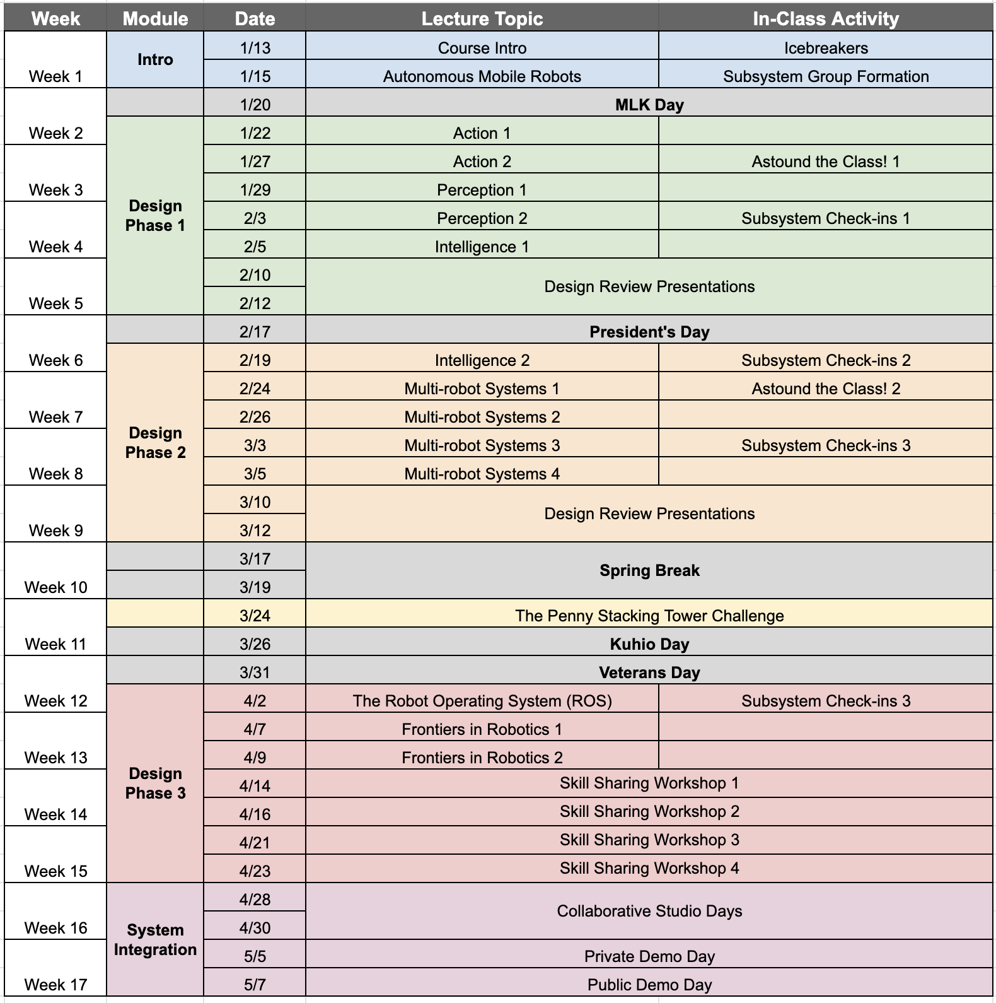
Course Schedule
-Three “Design Phases”
Five overarching lecture topics:
Action, Perception, Intelligence, Multi-robot Systems, Frontiers in Robotics

Slide 24
Course Schedule
Two assignments in the first 5 weeks.

Slide 25
Assignments in 693H
Astound-the-Class: Short (~3 minute, 2 slide) individual presentations on any bit of news, cutting-edge research, or fun fact related to autonomous mobile robots and/or multi-robot systems. Examples: Killer robots in Ukraine; Dario Floreano’s avian-inspired robot legs; How mantis shrimp claws work.
Design Review Presentations: ~20 minute group presentations on your robotic subsystem design progress. This can (and should) include a broad mix of technical content, things like “how we calculated this,” “why we chose this,” “this is what the prototype looks like.”
Skill-sharing Workshop: Full period (~1 hour) sessions where you will lead the class in learning something integral to your subsystem efforts. Examples: 3D modeling a robot chassis; Gazebo crash course; odometry and state estimation
Final Technical Report: Writeup of your design efforts in academic-standard format.

Slide 26
(Ungraded) Assignments in 693H
Readings: I will assign readings (videos, textbook pages, other people’s lecture notes, etc.) relevant to the week’s lecture topics. You are strongly encouraged to read these in order to help reinforce things I am saying in lecture.
Tasks: I will assign tasks for you to complete that will help you stay on track for meeting your design goals. An example is downloading a specific software package and progressing through a specific tutorial.

Slide 27
Grading in 693H
My approach to designing a course: Get everyone to engage with the material.
My approach to grading: Everyone who works hard does well.
Graduate course grading scale: Acceptable. Bad. Catastrophic
What if I am terrible at / afraid of public speaking: That’s okay.

Slide 28
A “Typical” Class Period
Lecture
Open time for design group work
~45 minutes
~30 minutes
(many of the periods will look very different than this!)

Slide 29
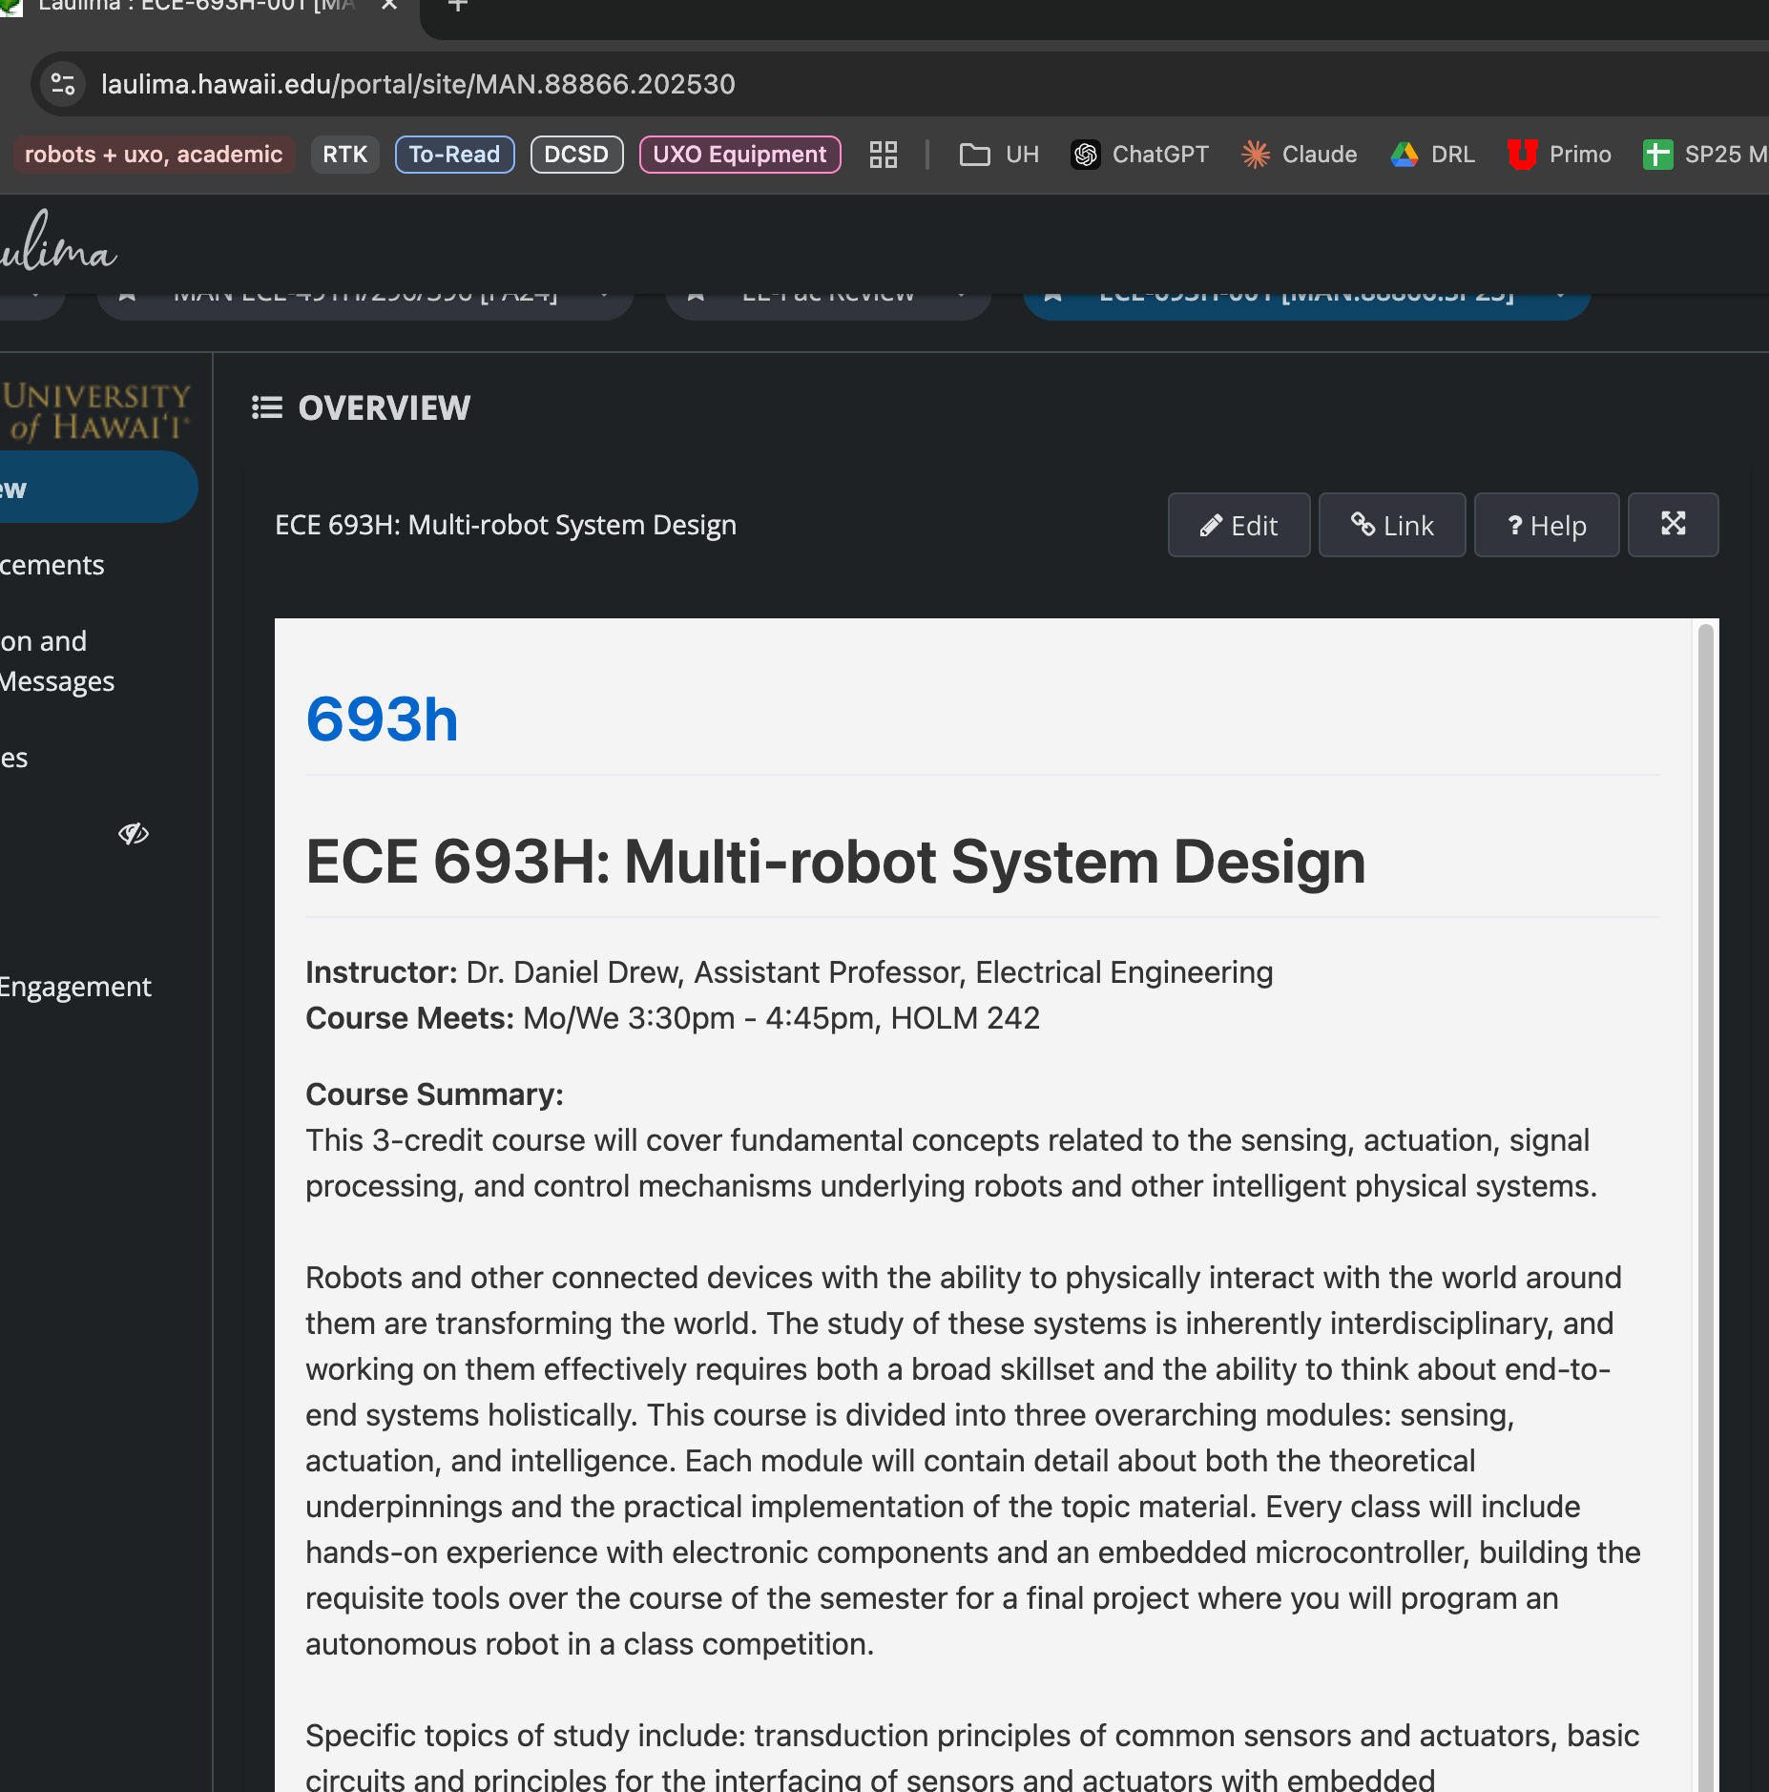
The Course Website + Laulima
https://danieldrew.me/693h/
and embedded in Laulima

Slide 30

A Disclaimer
This is a new course, and we are attempting to cover a lot of ground with a unique structure!
Ask questions – about the course structure/schedule as well as content!
Provide feedback via email, Canvas, office hours
Class Feedback Surveys will be offered for Extra Credit

Slide 31
In-Class Activity
Course Summary 1-pager: grab a paper and pen, divide your paper in half with a line. No wrong answers, no redos (unless something horrible happens):
Top half:
1) Write down these categories, and 3-5 short bullet points that come to mind for each, in the context of robotics: Action, Perception, Intelligence
Bottom half:
2) Draw a flowchart for designing an autonomous mobile robot from scratch. This should answer questions like how it will be powered, how it will move, how it will be controlled, and how it will be built, to the best of your ability. Use numbers with units whenever possible! (Hint: don’t know where to start? Start with the battery.)

Slide 32
Discuss In-Class Activity

Slide 33
Final Notes
Don’t forget to do the readings on the course website
Bringing a laptop to class is strongly suggested. Don’t have one? Talk to me after class or send an email.
Get software issues figured out early

